Slide 1
HyperGraph
Frankonello
08/08/2023

Slide 2
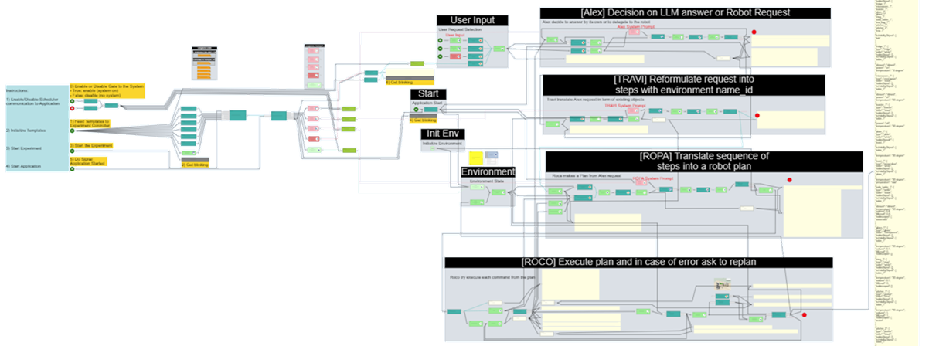
HyperGraph - Easy development of Model-driven Solutions
Be able to easily create applications or systems designed by drawing functional models.
Any type of model possible:
Dataflow
Control flow
Data model (ERD,…)
State Model
CodeFlow
Business process
Domain specific languages
Tool to create set of symbolic elements and assign functional semantic to them
Tool to draw graphs of symbolic elements to make them represent applications or systems models.
Code generator tools to translate models into runnable code in any language or in data files suited for integration in other projects
Run-time engine to execute models directly
Javascript, web technologies
Any target language or data format

Slide 3
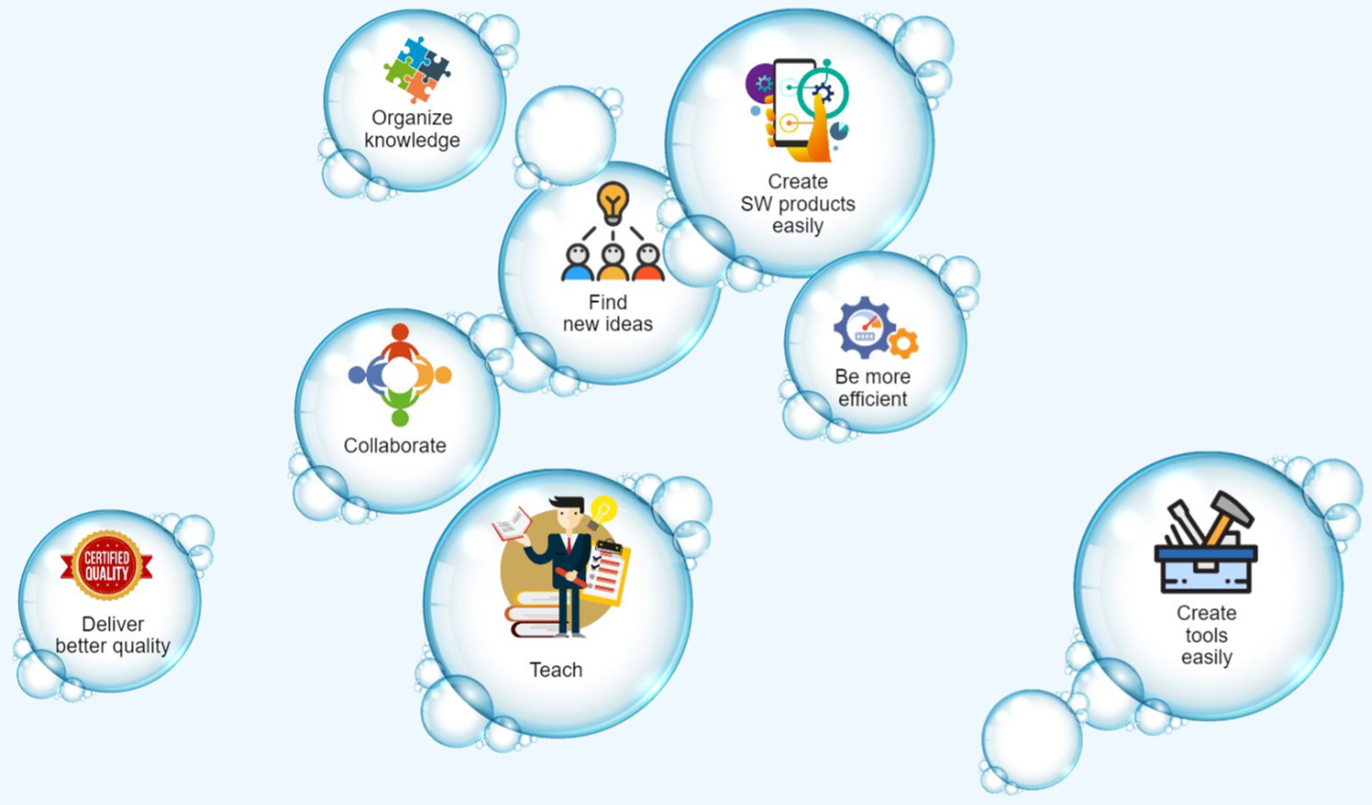
What is HyperGraph?
HyperGraph is a tool to visualize and manipulate information in an intuitive but additionally with programmatic way.
Project that started as a hobby in summer holiday 2019
Idea was to explore meta-modeling in a broad spectrum
Idea inspired by using Notion.io, FreeMind, Miro and knowledge on meta-modeling
Due to it’s abstract properties and available libraries, building such a platform was possible with minimal effort (2h/week in mean over 4 years)

Slide 4
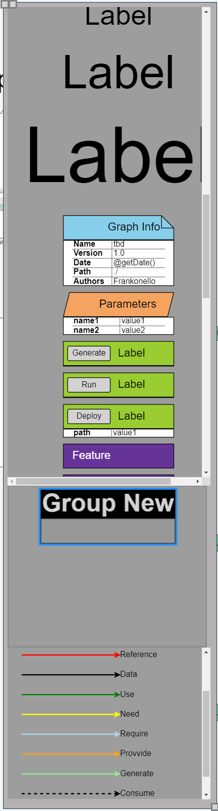

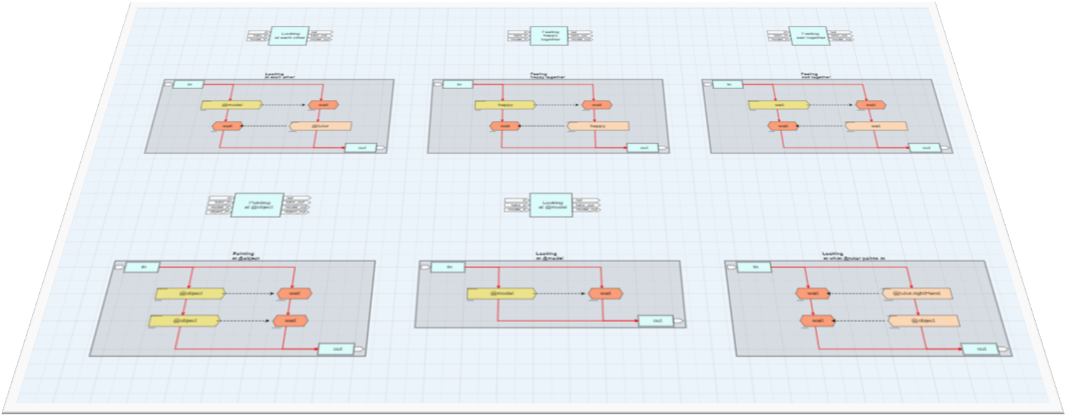
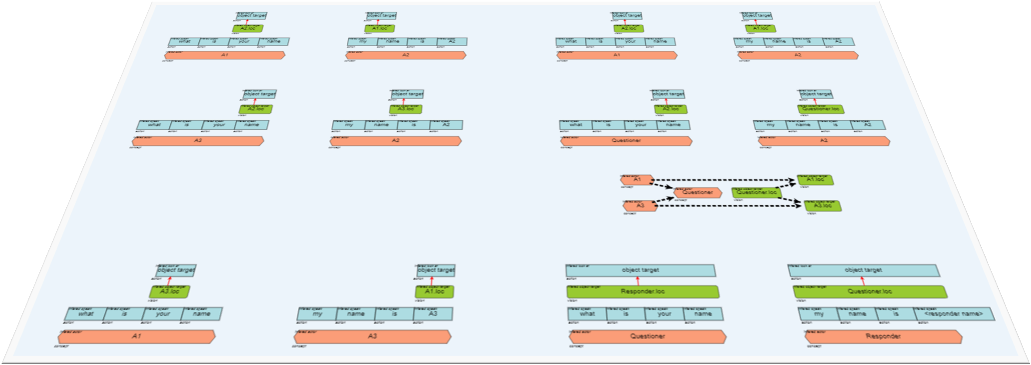
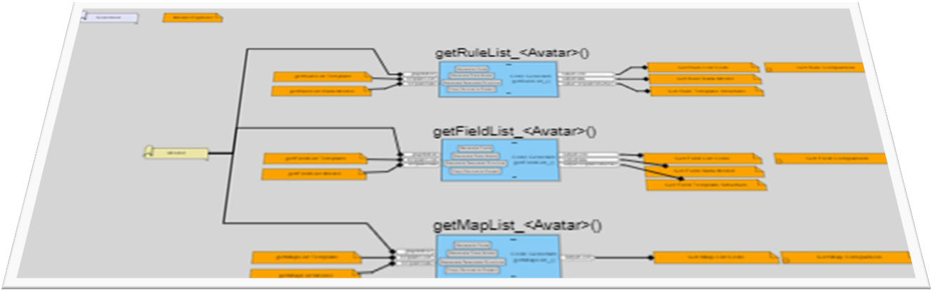
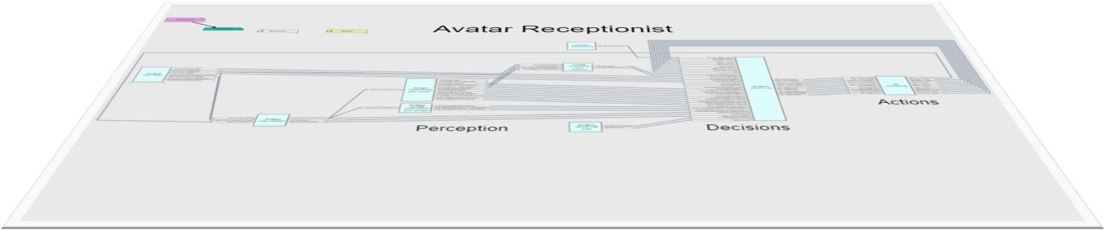
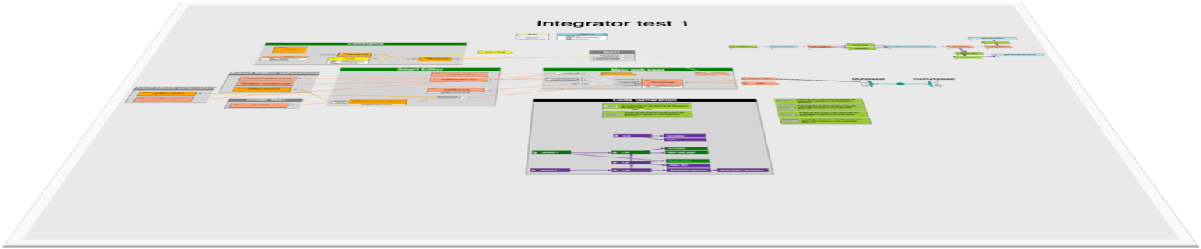

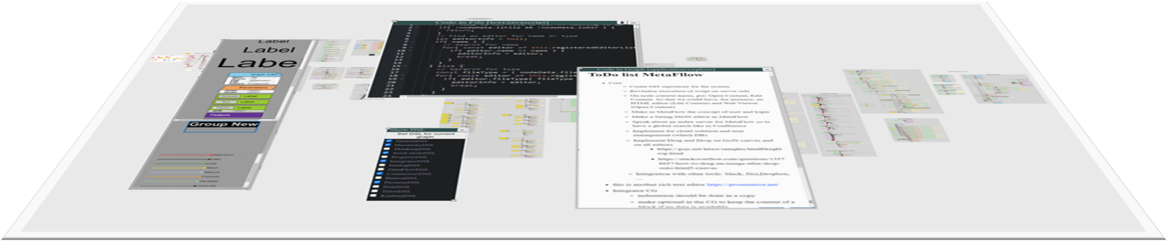

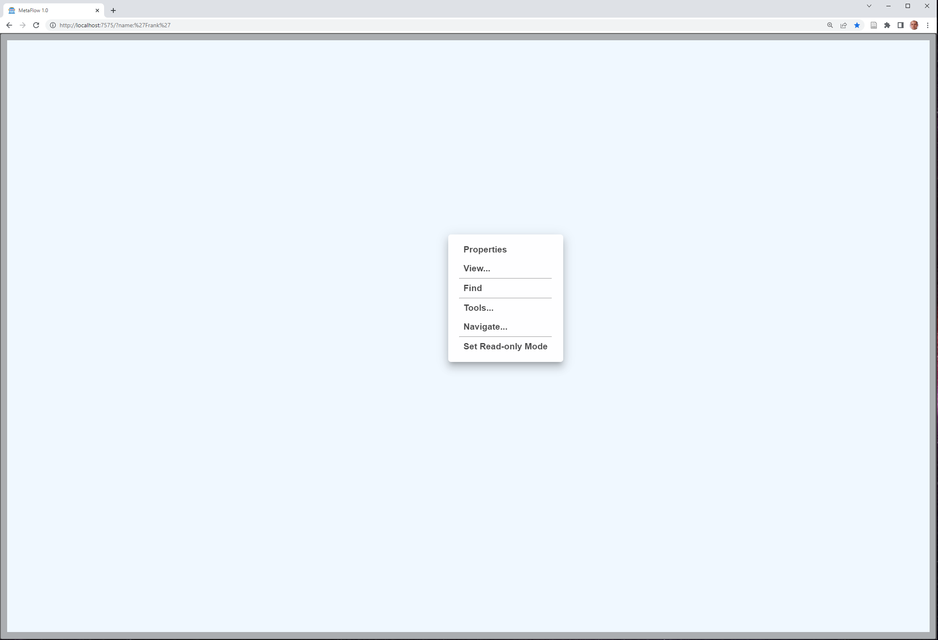







DSL
Navigation (Files, Gates) → OS
Brainstorming → Miro,…
DataFlow → ToolBOS, RTMaps,…
CodeFlow
DialogFlow → Avatar Receptionist
Workspace
Workspace
Data Model
Code Generation
Workspace
Workspace
Workspace
Workspace
Code
Doc
µServices
Program
Server
Browser
DB
App

Slide 5



HyperGraph Usage Process
HyperGraph can be used like compilers or IDE. It’s a productivity tool
JSON files
HyperGraph
C, C++, Python,… files

Slide 6
Hypergraph dependencies
HyperGraph is written in the following languages:
JavaScript (98%)
CSS and HTML
Hypergraph is based on the integration of several libraries
Graph creation “GoJS”: Commercial license (one time 4000€)
Graph creation “draw2D”: Open source MIT license (possible replacement of GoJS just started investigation in HyperGraph)
Text editor “Ace”: Open source MIT license
Rich text editor “Explore-Editor”: Open source MIT license
LateX syntax “Katex”: Open source MIT license
Window manager “WinBox”: Apache license 2.0
Server “NodeJS”: Creative Commons Attribution 4.0
HyperGraph is available in GitHub open-project under a free GPL license

Slide 7
Why it could be useful for HRI-EU?
For long time we just used HyperGraph for private investigations
First HRI use case: Avatar Receptionist
07/2020 First dialog model was based on yEdit + a dedicated Code generator (5 month)
02/2021 Investigation of MetaEdit+ for dialog model (2 month)
06/2021 Usage of HyperGraph to redesign dialog model (2 weeks)
Second HRI use case: Potential use for impact advisor meeting
03/2023 Presentation of the potential of the tool as an HRI innovation platform
04/2023 Presentation to the Memphis project for potential use of HyperGraph
04/2023 Check patentability with Krishna
Third HRI use case: Request to develop LLM planning for Smile
06/2023 DSL creation for ChatGPT, Smile simulator integration, MVP of planning (1 week)

